Slide 1
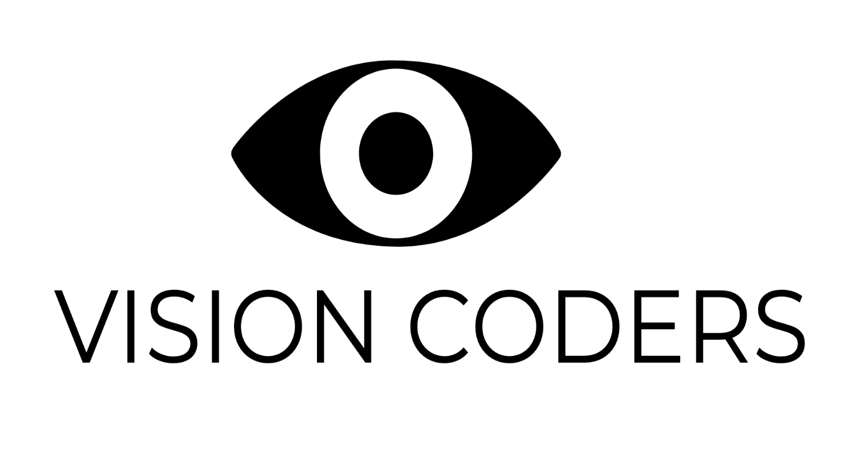
VISION CODERS
ARTIFICIAL INTELLIGENCE BASED AUTOMATED PROCTORING SYSTEM
A System which helps proctoring and interacting with students in the class
Vision Coders. | AI Based Proctoring System

Slide 2
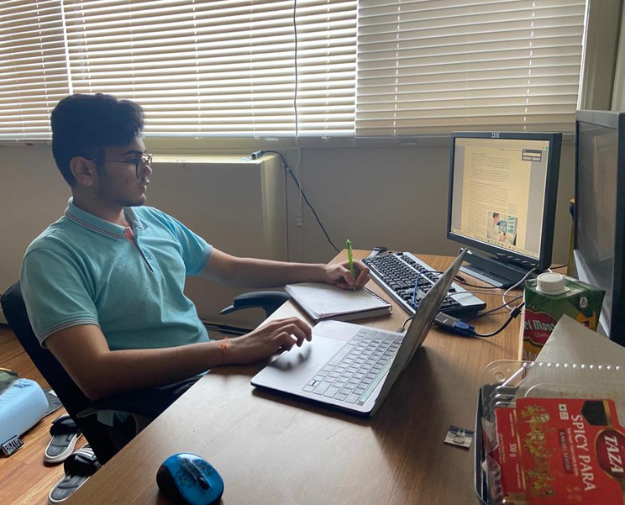
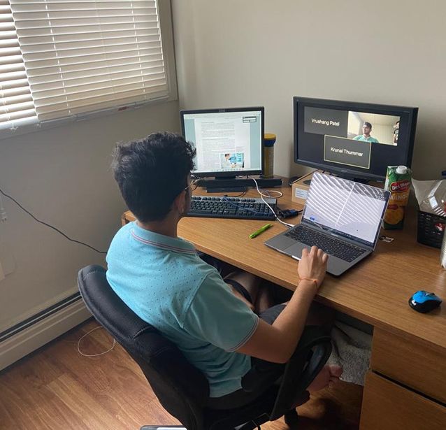
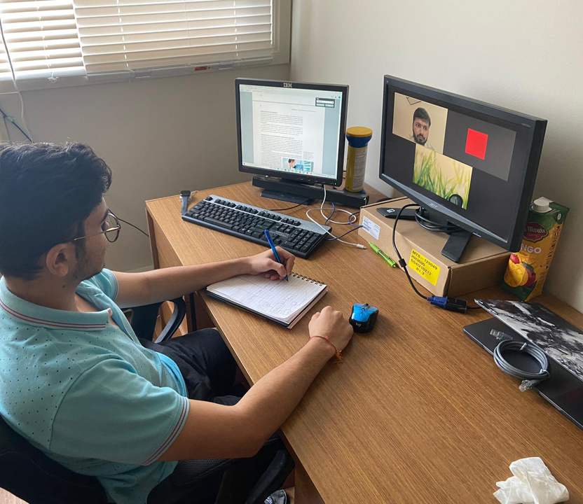
Problem-1(Examination situations)
IMAGE-1
IMAGE-2
IMAGE-3
Note :- This is an example that shows that there are chances of academic misconduct during online-exams.
Vision Coders. | AI Based Proctoring System

Slide 3
Vision Coders. | AI Based Proctoring System
Problem-2(Lack of engagement)
Note:- This above picture give examples of distraction during ongoing class sessions

Slide 4

Major Drawbacks using other video conferences software
Due to large amount of students in a class it becomes hard to find out which student is misconducting the exam rules.
Some of the features that are not provided by other software are:-
Facial movements.
Lip movements.
Eyeball motion.
Physical Presence.
Vision Coders. | AI Based Proctoring System

Slide 5
OUR UNIQUE SELLING POINT
A fully automated system which helps an invigilator to proctor a class of more than 250 students at a time.
A system which alarms students about drowsiness during ongoing class sessions inorder to maintain the flow.
Our system alarms the Invigilator and gives suggestions to send warnings to students who found misconducting examination rules.
This web application-based software can be used in other fields by making minor changes for example Surveillance systems, Artificial Intelligence Monitor
Vision Coders | AI Based Proctoring System

Slide 6
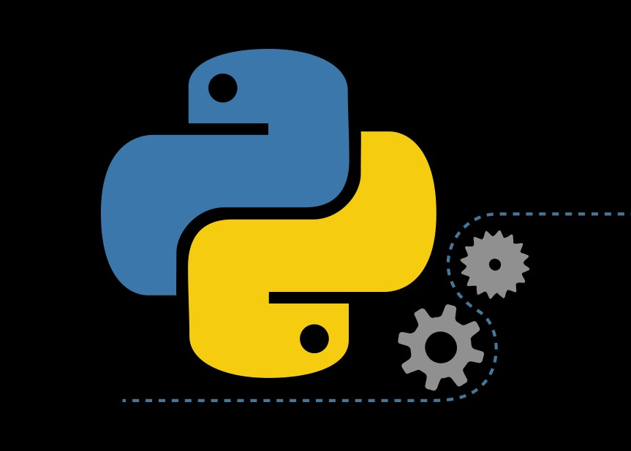
Technology Used
Python
Python 3.6
OpenCV
Deep Learning And Machine Learning
Flask
Computer Vision
Web development frameworks includes
HTML
CSS
JavaScript
Vision Coders. | AI Based Proctoring System

Slide 7

What We Want to Reflect
BODY LANGUAGE ANALYSIS
ACADEMIC DISHONESTY
ACADEMIC INTEGRITY
DROWSINESS
Vision Coders | AI Based Proctoring System

Slide 8
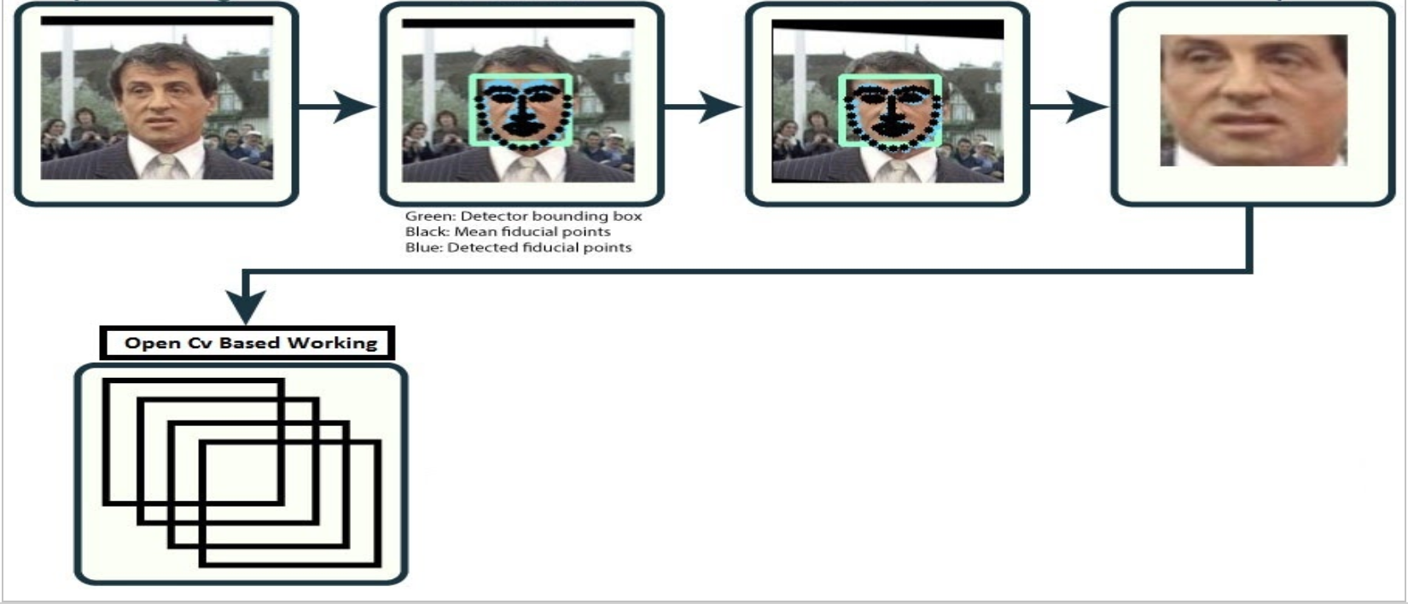
THE WAY IT WORKS
INPUT VIDEO
DETECT
TRANSFORM
CROP
Vision Coders. | AI Based Proctoring System

Slide 9
Let's Go!
Website map
Vision Coders. | AI Based Proctoring System

Slide 10
User Interface of Our System
image of the user interface
3*image
Vision Coders. | AI Based Proctoring System

Slide 11
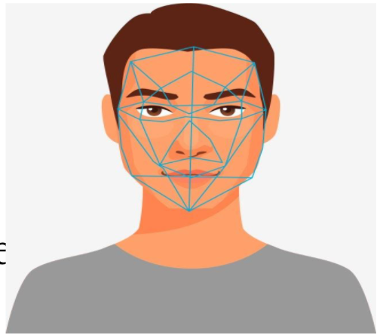
Solution
The human face has certain landmarks. The below image clearly justifies the peaks and valleys up the different facial features. Software defines these landmarks as nodal points.
These are about "80" nodal points on the human face.
Following are the few nodal points that are recognized by our software by applying some mathematical formulas on them we can detect following tasks:-
Presence of face.
Eyeball motions.
Movement of face.
Movement of lips.
Vision Coders. | AI Based Proctoring System

Slide 12
Vision Coders. | AI Based Proctoring System
FUTURE COST
SILVER
GOLD
PLATINIUM
Host up to 200 participants
unlimited 1-1 meeting sessions
Drowsiness, presence of face pack.
Host up to 250 participants
unlimited group meeting sessions.
Eyeball, Lip detection pack.
Host up to 350 participants.
Combo of all features.
pupil , face detection, lip, drowsiness pack.
1 MONTH FREE TRIAL !
CANCEL ANYTIME
CAD 299/yr.
CAD
599/yr.
CAD
699/yr.

Slide 13
Team Members
Vrushang Patel - Graduate Student at University Of Winnipeg.
Krunal Thummar - Graduate Student at University Of Winnipeg.
Ayush Amin - Undergraduate Student at University Of Winnipeg
Vision Coders. | AI Based Proctoring System

Slide 14
References:-
https://support.zoom.us/hc/en-us/articles/201362323-Changing-the-video-layout-Active-Speaker-View-and-Gallery-View-
http://weknowyourdreams.com/single/python/python-11
https://cxl.com/blog/javascript-vs-python/
Vision Coders. | AI Based Proctoring System

Slide 15
THANK YOU FOR YOUR TIME!
Vision Coders. | AI Based Proctoring System

